Slide 1
Binary Search Trees (BST)
Oswald c
BST Invented by
P.F. Windley, A.D. Booth (Booth multipl.algo),
A.J.T. Colin (Inventor of Binary Tree), and T.N. Hibbard in 1960
The class notes are a compilation and edition from many sources. The faculty does not claim intellectual property or ownership of the lecture notes. Thanks to them!

Slide 2
Binary Trees
Recursive definition
  An empty tree is a binary tree
  A node with two child subtrees is a binary tree
  Only what you get from 1 by a finite number of applications of 2 is a binary tree.
Is this a binary tree?
56
26
200
18
28
190
213
12
24
27

Slide 3
Binary Search Trees
View today as data structures that can support
dynamic set operations.
  Search, Minimum, Maximum, Predecessor, Successor, Insert, and Delete.
Can be used to build
  Dictionaries.
  Priority Queues.
Basic operations take time proportional to the height of the tree – O(h).

Slide 4
Dictionary ADT:
Used Everywhere
Arrays
Sets
Dictionaries
Router tables
Page tables
Symbol tables
C++ structures
…
Anywhere we need to find things fast based on a key
Notes:
Our ADT algorithm says to look at some applications at this point. I think the first app pretty much says it all. We move on from there however, to other incredibly widely used applications.
Dictionary is probably the most important and one of the most widely used ADTs.

Slide 5
BST – Representation
Represented by a linked data structure of nodes.
root(T) points to the root of tree T.
Each node contains fields:
  key
  left – pointer to left child: root of left subtree.
  right – pointer to right child : root of right subtree.
  p – pointer to parent. p[root[T]] = NIL (optional).
struct Node
{
int key;
struct Node *left, *right ;
};

Slide 6
Binary Search Tree Property
Stored keys must satisfy the binary search tree property.
  ∀ y in left subtree of x, then key[y] ≤ key[x].
  ∀ y in right subtree of x, then key[y] > key[x].
56
26
200
18
28
190
213
12
24
27

Slide 7
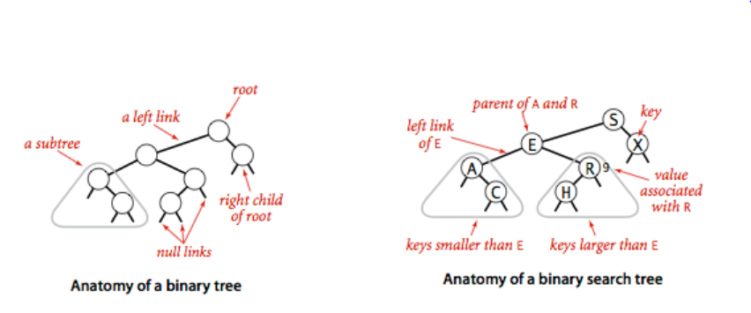
Anatomy of BT and BST
Anatomy – identification and description of the structures of an object

Slide 8

Two binary search trees representing the same set:

Slide 9
Complete Binary Search Tree
Complete binary search tree
(aka binary heap):
  Links are completely filled, except possibly bottom level, which is filled left-to-right.
8
5
15
3
7
9
17
1
4
6

Slide 10
Inorder Traversal
The binary-search-tree property allows the keys of a binary search tree to be printed, in (monotonically increasing) order, recursively.
Inorder-Tree-Walk (x)
1. if x ≠ NIL
2. then Inorder-Tree-Walk(left[p])
3. print key[x]
4. Inorder-Tree-Walk(right[p])
56
26
200
18
28
190
213
12
24
27
How long does the walk take?
Construct BST: 7, 0, -1, 45, 23, 28, 34, 56, 54, 60, 42, 32, 2

Slide 11
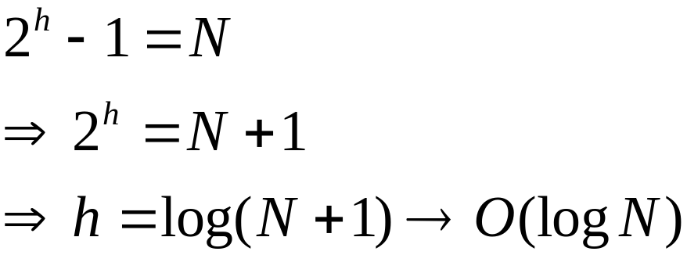
Querying a Binary Search Tree
All dynamic-set search operations can be supported in O(h) time. h determines running time!
h = Θ(lg n) for a balanced binary tree (and for an average tree built by adding nodes in random order.)
h = Θ(n) for an unbalanced tree that resembles a linear chain of n nodes in the worst case.
What is the height h of a full tree with N nodes?

Slide 12
Tree Search
Tree-Search(x, k)
1. if x = NIL or k = key[x]
2. then return x
3. if k < key[x]
4. then return Tree-Search(left[x], k)
5. else return Tree-Search(right[x], k)
56
26
200
Running time: O(h)
Aside: tail-recursion
18
28
190
213
12
24
27

Slide 13
Iterative Tree Search
Iterative-Tree-Search(x, k)
1. while x ≠ NIL and k ≠ key[x]
2. do if k < key[x]
3. then x ← left[x]
4. else x ← right[x]
5. return x
56
26
200
18
28
190
213
12
24
27
The iterative tree search is more efficient on most computers.
The recursive tree search is more straightforward.

Slide 14
Finding Min & Max
The binary-search-tree property guarantees that:
  The minimum is located at the left-most node.
  The maximum is located at the right-most node.
Tree-Minimum(x) Tree-Maximum(x)
1. while left[x] ≠ NIL 1. while right[x] ≠ NIL
2. do x ← left[x] 2. do x ← right[x]
3. return x 3. return x
Q: How long do they take?

Slide 15
BST Bonus:
FindMin, FindMax
Find minimum
Find maximum
10
5
15
2
9
20
7
17
30

Slide 16
BuildTree for BSTs
Suppose the data 1, 2, 3, 4, 5, 6, 7, 8, 9 is inserted into an initially empty BST:
  in order
  in reverse order
  median first, then left median, right median, etc.
Notes:
OK, let’s buildTree. How long does this take?
Well, IT DEPENDS!
Let’s say we want to build a tree from 123456789
What happens if we insert in order?
Reverse order?
What about 5, then 3, then 7, then 2, then 1, then 6, then 8, then 9?

Slide 17
Predecessor and Successor
Successor of node x is the node y such that key[y] is the smallest key greater than key[x].
The successor of the largest key is NIL.
Search consists of two cases.
  If node x has a non-empty right subtree, then x’s successor is the minimum in the right subtree of x.
  If node x has an empty right subtree, then:
    As long as we move to the left up the tree (move up through right children), we are visiting smaller keys.
    x’s successor y is the node that x is the predecessor of (x is the maximum in y’s left subtree).
    In other words, x’s successor y, is the lowest ancestor of x whose left child is also an ancestor of x.

Slide 18
Successor Node
Next larger node
in this node’s subtree
10
5
15
2
9
20
7
17
30
How many children can the successor of a node have?
Notes:
Here’s a little digression.
Maybe it’ll even have an application at some point.
Find the next larger node in 10’s subtree.
Can we define it in terms of min and max?
It’s the min of the right subtree!

Slide 19
Predecessor Node
Next smaller node
in this node’s subtree
10
Node * pred(Node * t) {
if (t->left == NULL)
return NULL;
else
return max(t->left);
}
5
15
2
9
20
7
17
30
Notes:
Predecessor is just the mirror problem.

Slide 20
Pseudo-code for Successor
Tree-Successor(x)
if right[x] ≠ NIL
2. then return Tree-Minimum(right[x])
3. y ← p[x]
4. while y ≠ NIL and x = right[y]
5. do x ← y
6. y ← p[y]
7. return y
56
26
200
Code for predecessor is symmetric.
Running time: O(h)
18
28
190
213
12
24
27

Slide 21
BST Insertion – Pseudocode
Change the dynamic set represented by a BST.
Ensure the binary-search-tree property holds after change.
Insertion is easier than deletion.
Tree-Insert(T, z)
y ← NIL
x ← root[T]
while x ≠ NIL
do y ← x
if key[z] < key[x]
then x ← left[x]
else x ← right[x]
p[z] ← y
if y = NIL
then root[t] ← z
else if key[z] < key[y]
then left[y] ← z
else right[y] ← z
56
26
200
18
28
190
213
12
24
27

Slide 22
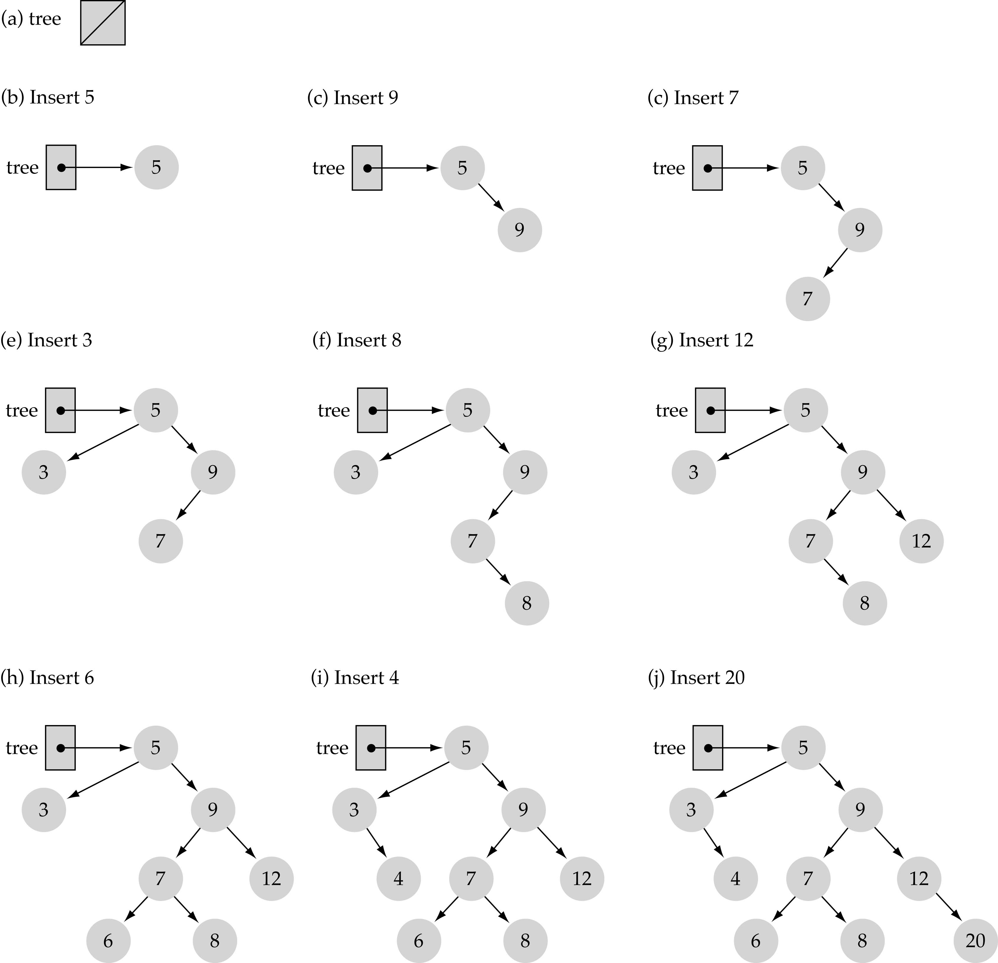
Insert
Use the binary search tree property to insert the new item at the correct place

Slide 23
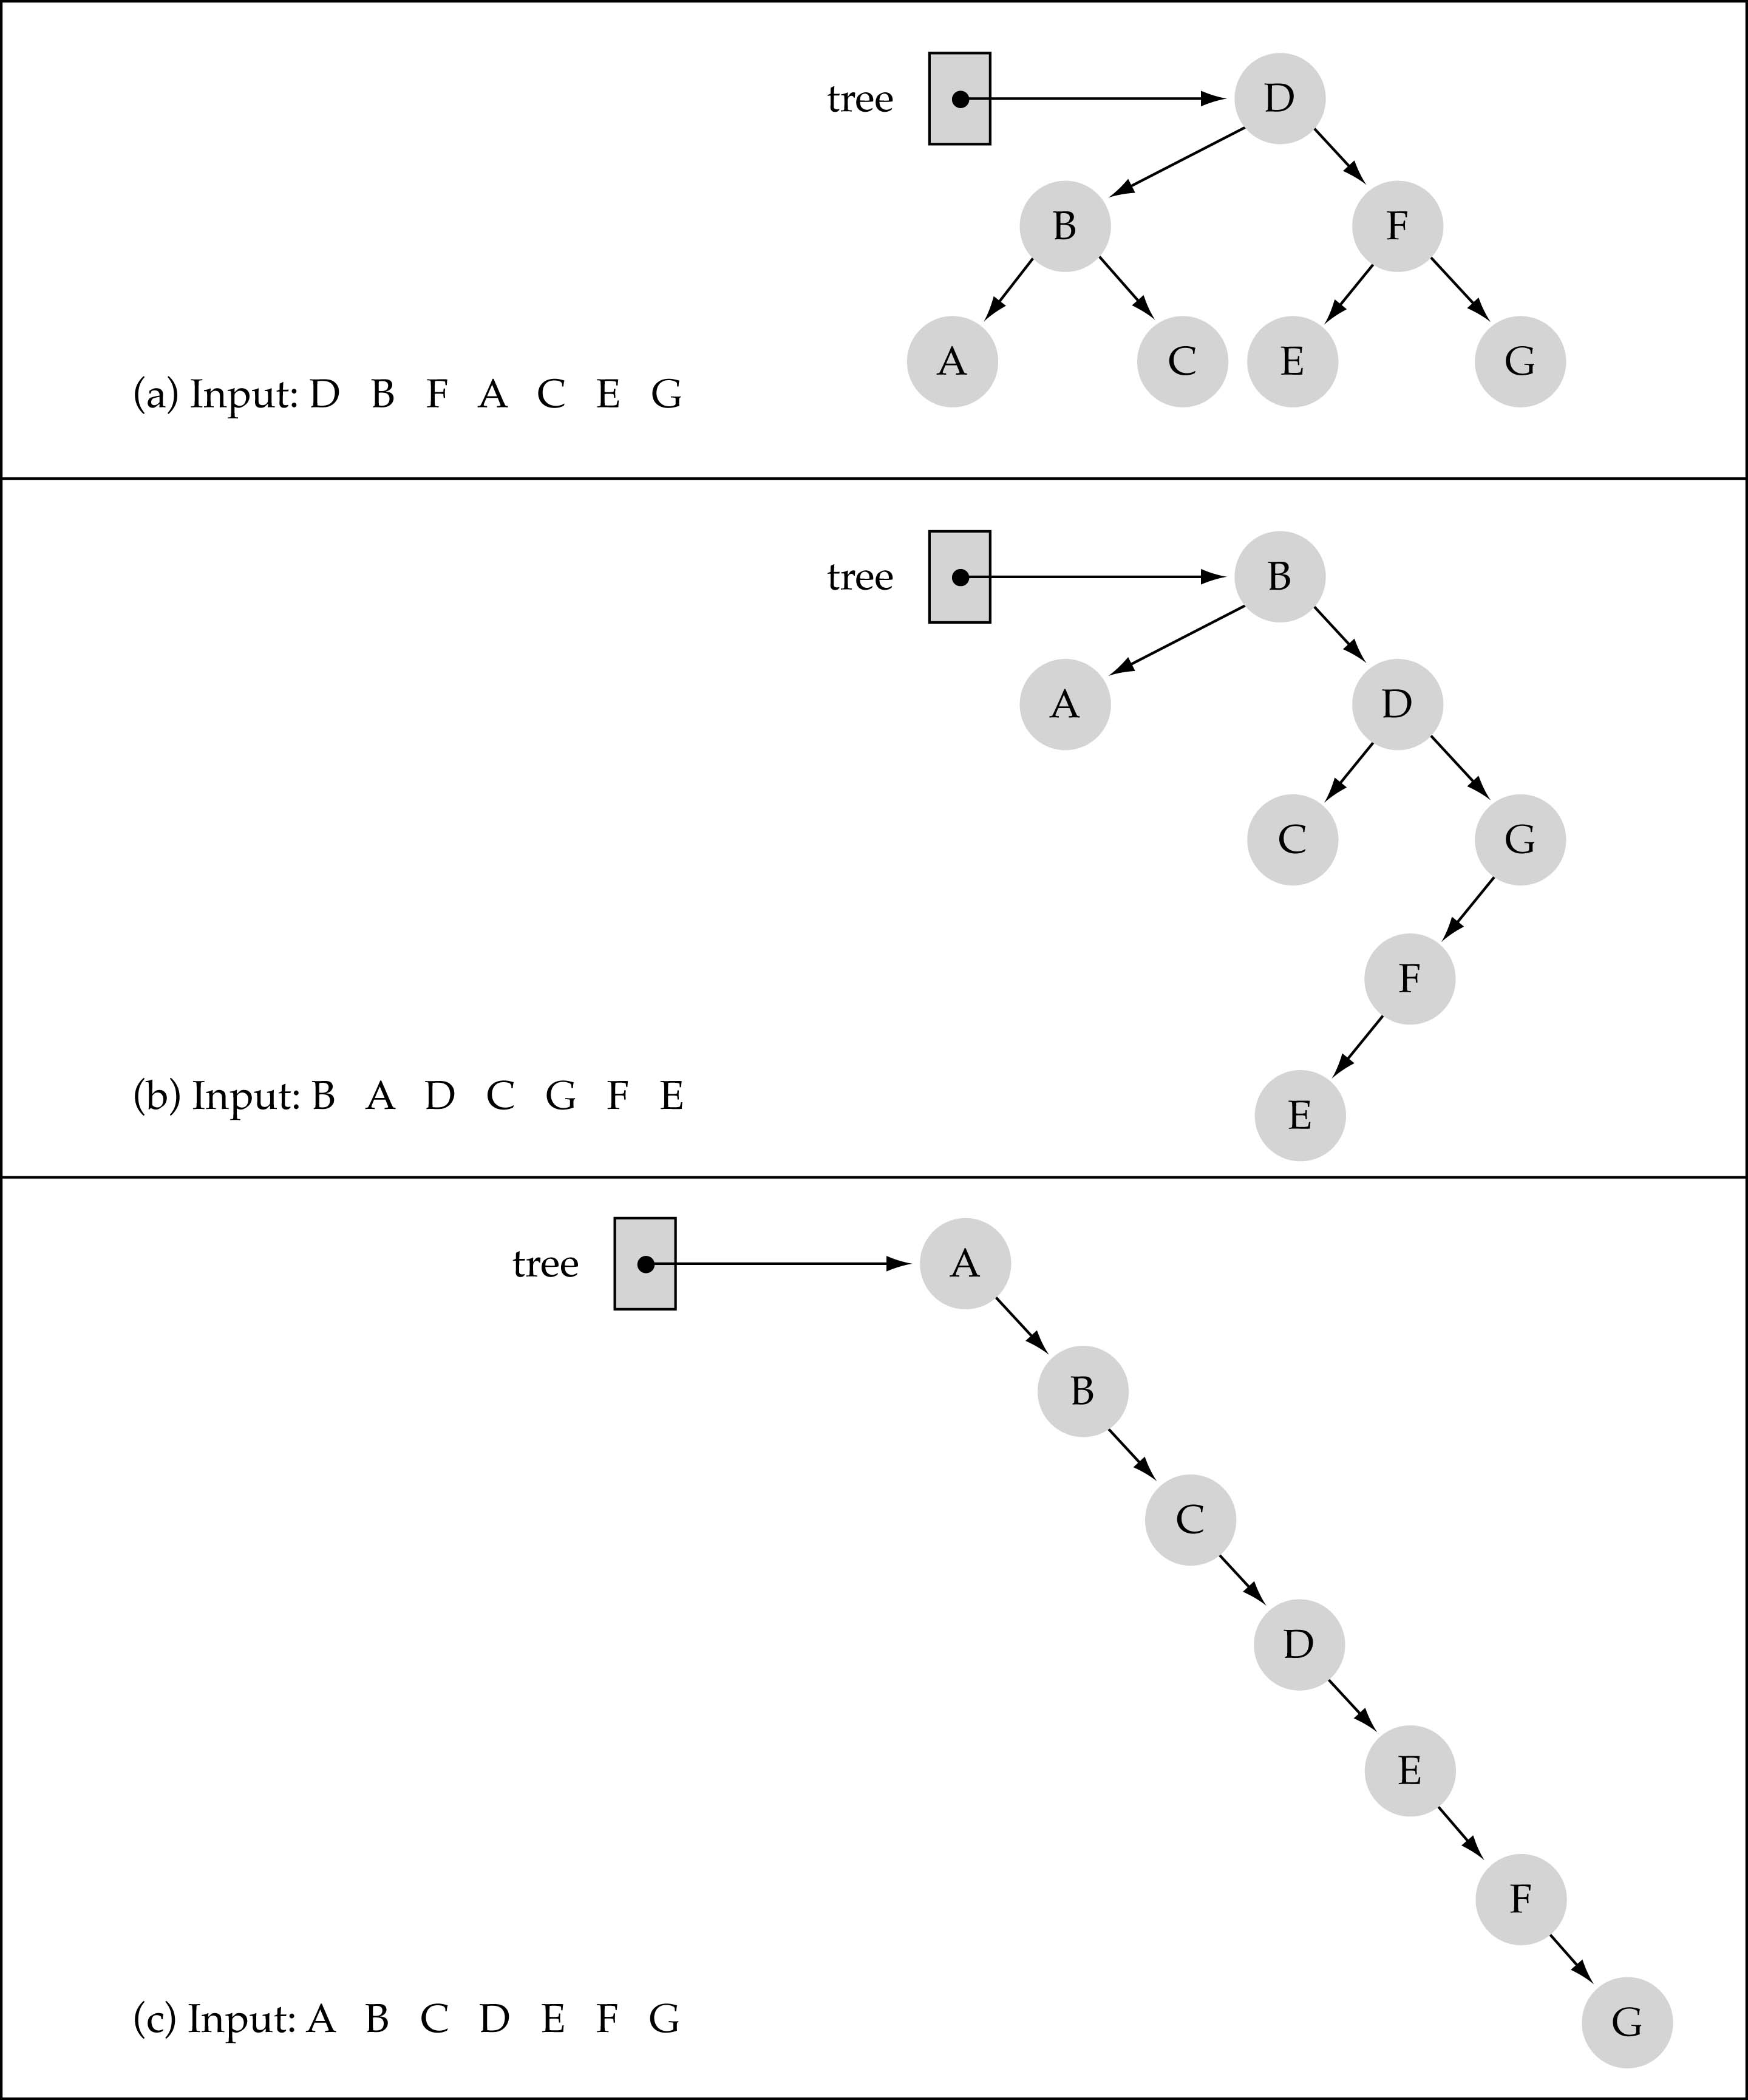
Does the order of inserting elements into a tree matter?

Slide 24
Analysis of Insertion
Tree-Insert(T, z)
y ← NIL
x ← root[T]
while x ≠ NIL
do y ← x
if key[z] < key[x]
then x ← left[x]
else x ← right[x]
p[z] ← y
if y = NIL
then root[t] ← z
else if key[z] < key[y]
then left[y] ← z
else right[y] ← z
Initialization: O(1)
While loop in lines 3-7 searches for place to insert z, maintaining parent y.
This takes O(h) time.
Lines 8-13 insert the value: O(1)
⇒ TOTAL: O(h) time to insert a node.

Slide 25
Exercise: Sorting Using BSTs
Sort (A)
for i ← 1 to n
do tree-insert(A[i])
inorder-tree-walk(root)
  What are the worst case and best case running times?
  In practice, how would this compare to other sorting algorithms?

Slide 26
Tree-Delete (T, x)
if x has no children ♦ case 0
then remove x
if x has one child ♦ case 1
then make p[x] point to child
if x has two children (subtrees) ♦ case 2
then swap x with its successor
perform case 0 or case 1 to delete it
⇒ TOTAL: O(h) time to delete a node

Slide 27
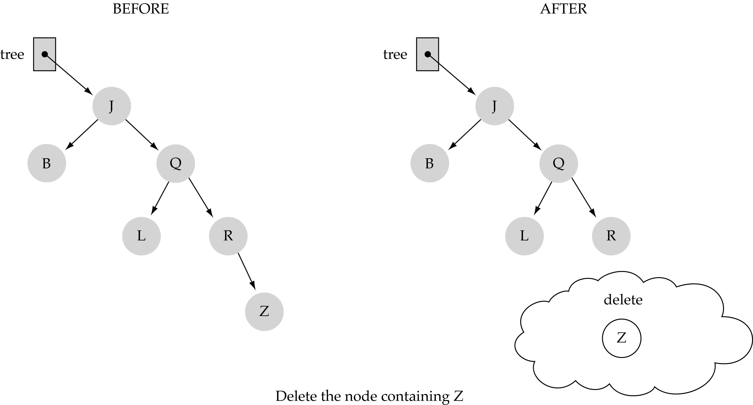
(1) Deleting a leaf

Slide 28
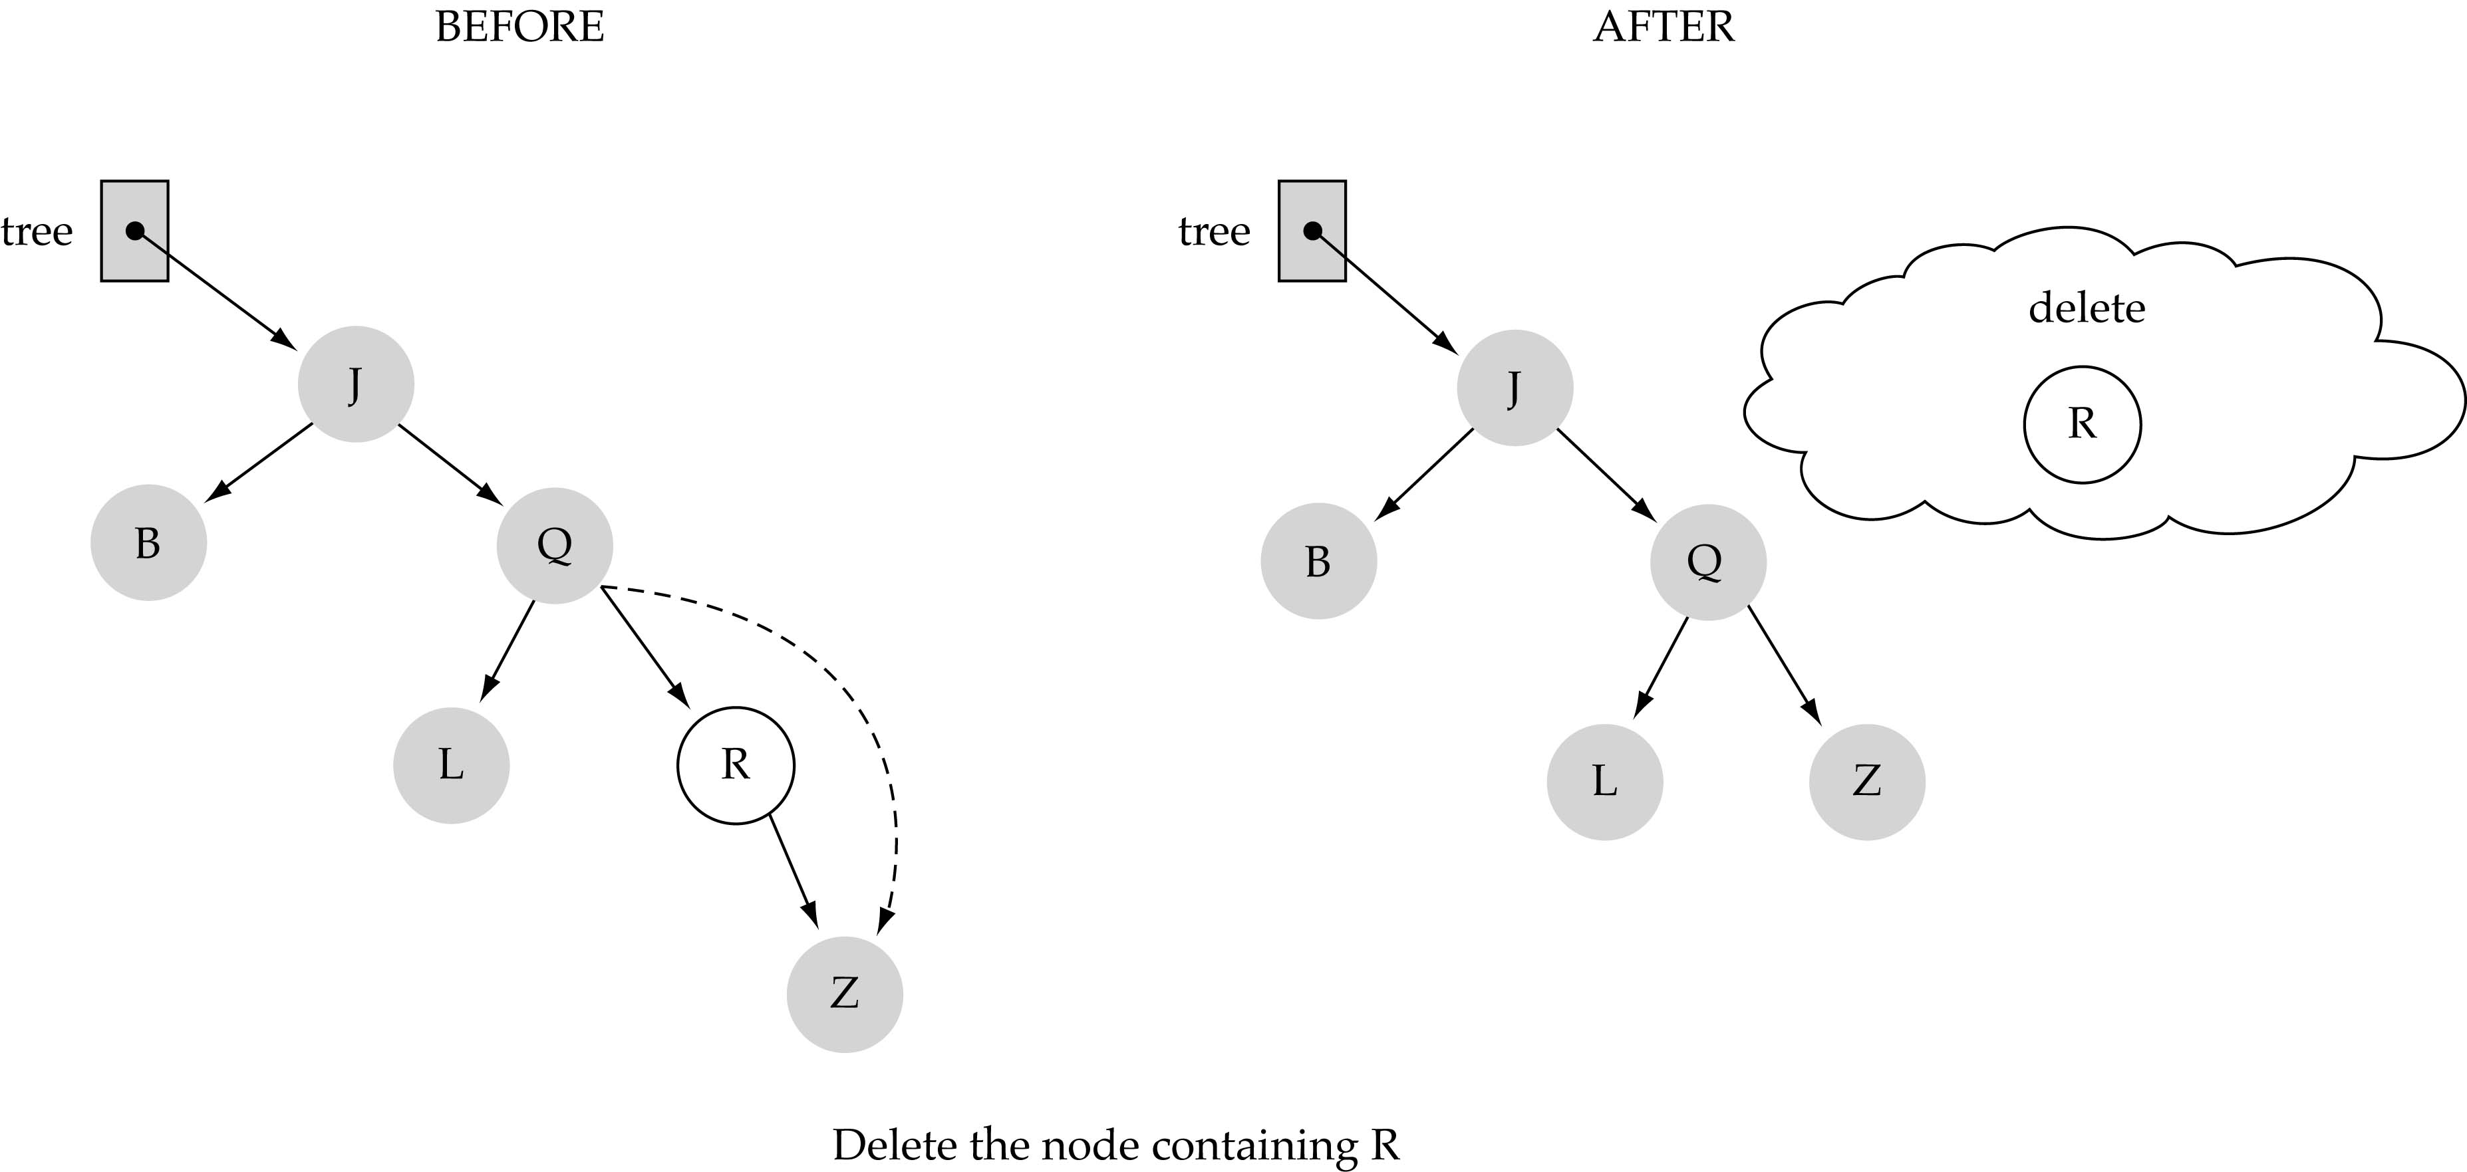
(2) Deleting a node with only one child

Slide 29
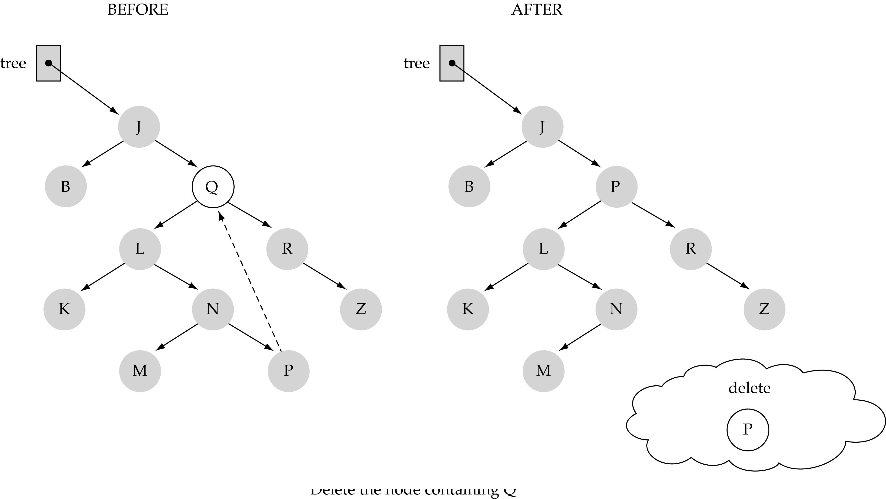
(3) Deleting a node with two children

Slide 30
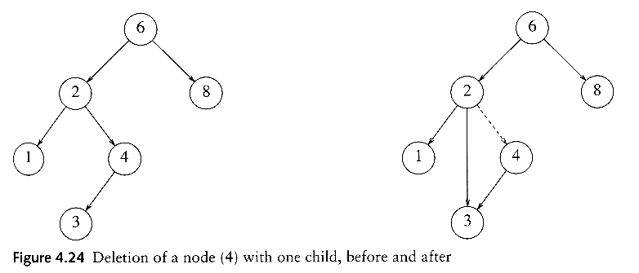
delete
Three cases:
(1) the node is a leaf
  Delete it immediately
(2) the node has one child
  Adjust a pointer from the parent to bypass that node

Slide 31
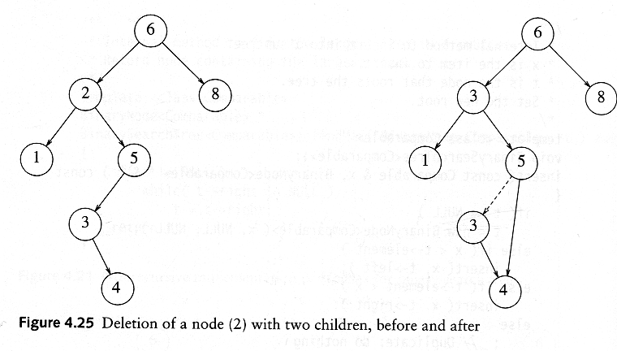
delete
(3) the node has 2 children
  replace the key of that node with the minimum element at the right subtree (successor)
  delete the minimum element
    Has either no child or only right child because if it has a left child, that left child would be smaller and would have been chosen. So invoke case 1 or 2.
Time complexity = O(height of the tree)
Notes:
Ah, now the hard case.
How do we delete a two child node?
We remove it and replace it with what?
It has all these left and right children that need to be greater and less than the new value (respectively).
Is there any value that is guaranteed to be between the two subtrees?
Two of them: the successor and predecessor!
So, let’s just replace the node’s value with it’s successor and then delete the succ.

Slide 32
Deletion – Pseudocode
Tree-Delete(T, z)
/* Determine which node to splice out: either z or z’s successor. */
if left[z] = NIL or right[z] = NIL
then y ← z
else y ← Tree-Successor[z]
/* Set x to a non-NIL child of x, or to NIL if y has no children. */
if left[y] ≠ NIL
then x ← left[y]
else x ← right[y]
/* y is removed from the tree by manipulating pointers of p[y] and x */
if x ≠ NIL
then p[x] ← p[y]
/* Continued on next slide */

Slide 33
Deletion – Pseudocode
Tree-Delete(T, z) (Contd. from previous slide)
if p[y] = NIL
then root[T] ← x
else if y ← left[p[i]]
then left[p[y]] ← x
else right[p[y]] ← x
/* If z’s successor was spliced out, copy its data into z */
if y ≠ z
then key[z] ← key[y]
copy y’s data into z.
return y

Slide 34
Function NumberOfNodes
Recursive implementation
#nodes in a tree =
  #nodes in left subtree + #nodes in right subtree + 1
What is the size factor?
  Number of nodes in the tree we are examining
What is the base case?
  The tree is empty
What is the general case?
  CountNodes(Left(tree)) + CountNodes(Right(tree)) + 1

Slide 35
BuildTree for BSTs
Suppose the data 1, 2, 3, 4, 5, 6, 7, 8, 9 is inserted into an initially empty BST:
  in order
  in reverse order
  median first, then left median, right median, etc.
Notes:
OK, let’s buildTree. How long does this take?
Well, IT DEPENDS!
Let’s say we want to build a tree from 123456789
What happens if we insert in order?
Reverse order?
What about 5, then 3, then 7, then 2, then 1, then 6, then 8, then 9?

Slide 36
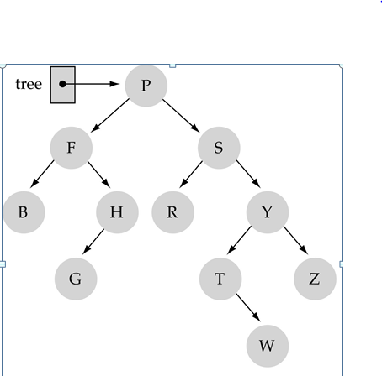
Tree Traversals: another example

Slide 37
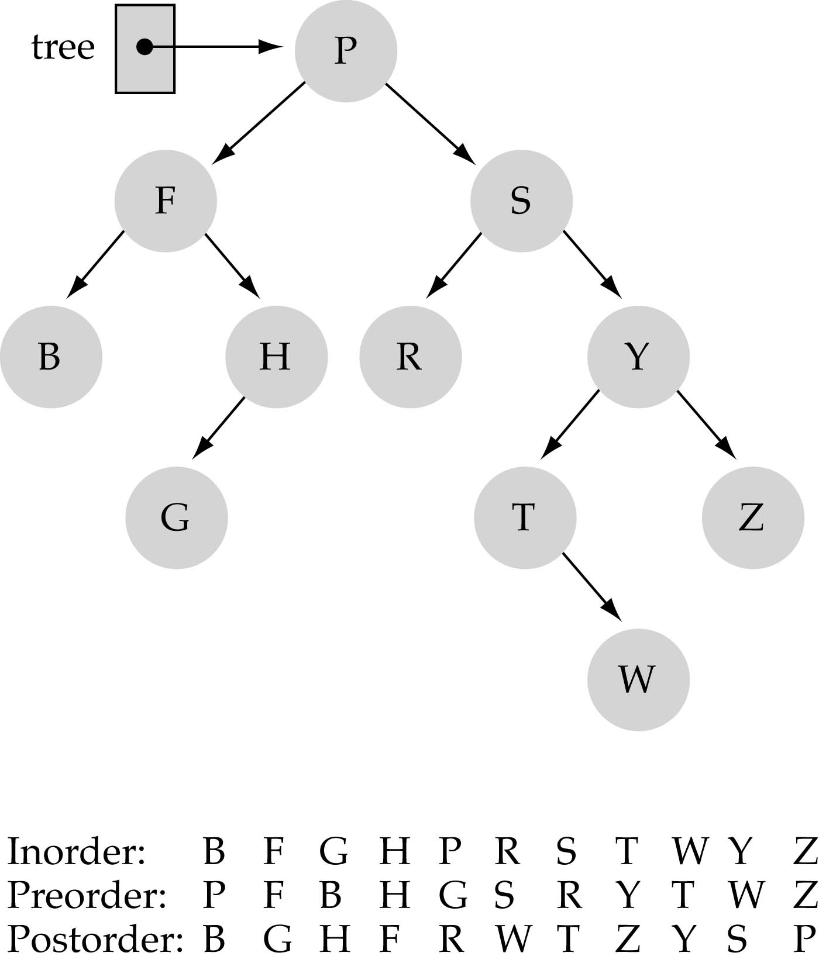
Tree Traversals: another example

Slide 38
Thinking about
Binary Search Trees…
Observations
  Each operation views two new elements at a time
  Elements (even siblings) may be scattered in memory
  Binary search trees are fast if they’re shallow
Realities
  For large data sets, disk accesses dominate runtime
  Some deep and some shallow BSTs exist for any data
BST’s looking good for shallow trees, i.e. if Depth is small (log n); otherwise as bad as a linked list!

Slide 39
Comparing Binary Search Trees to Linear Lists
Big-O Comparison
Operation | Binary Search Tree | Array-based List | Linked List
Constructor | O(1) | O(1) | O(1)
Destructor | O(N) | O(1) | O(N)
IsFull | O(1) | O(1) | O(1)
IsEmpty | O(1) | O(1) | O(1)
RetrieveItem | O(logN^{)*} | O(logN) | O(N)
InsertItem | O(logN^{)*} | O(N) | O(N)
DeleteItem | O(logN)* | O(N) | O(N)
*assuming h=O(logN)
*assuming h=O(logN)

Slide 40
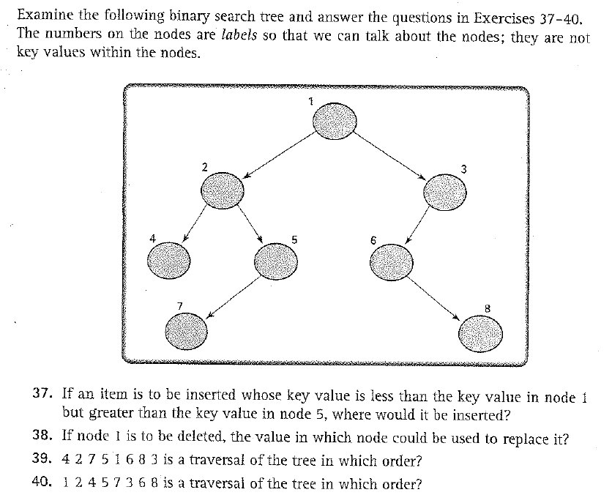
Exercises

Slide 41
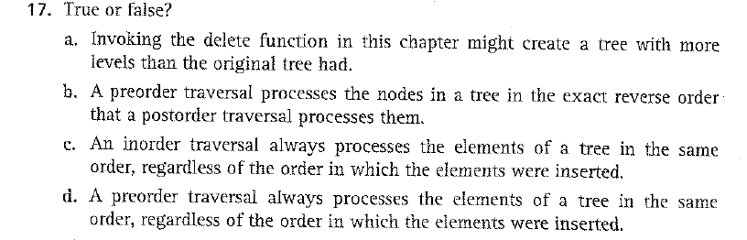
Exercises

